Slide 1
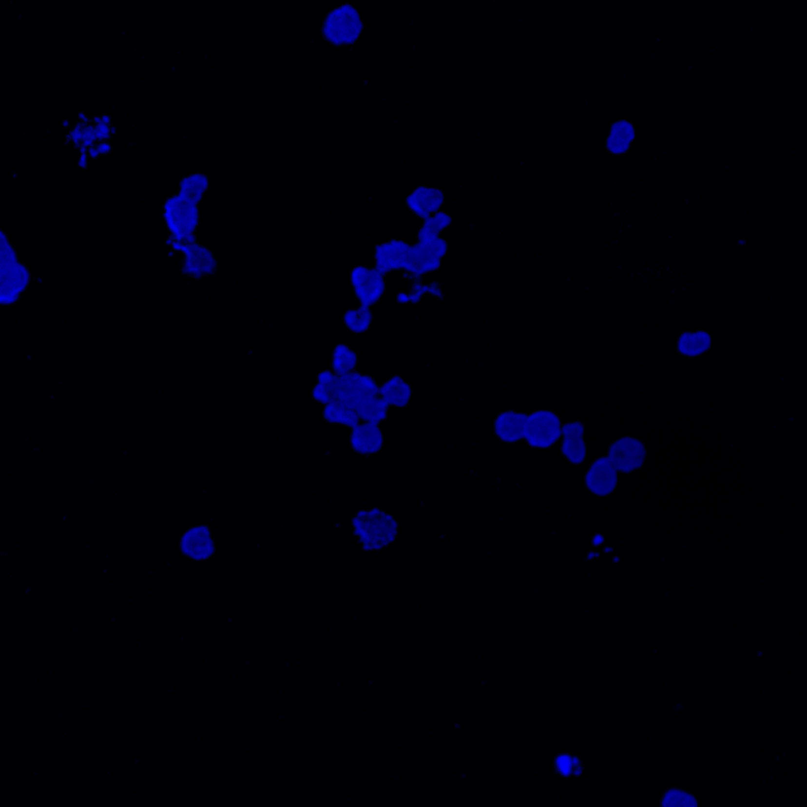
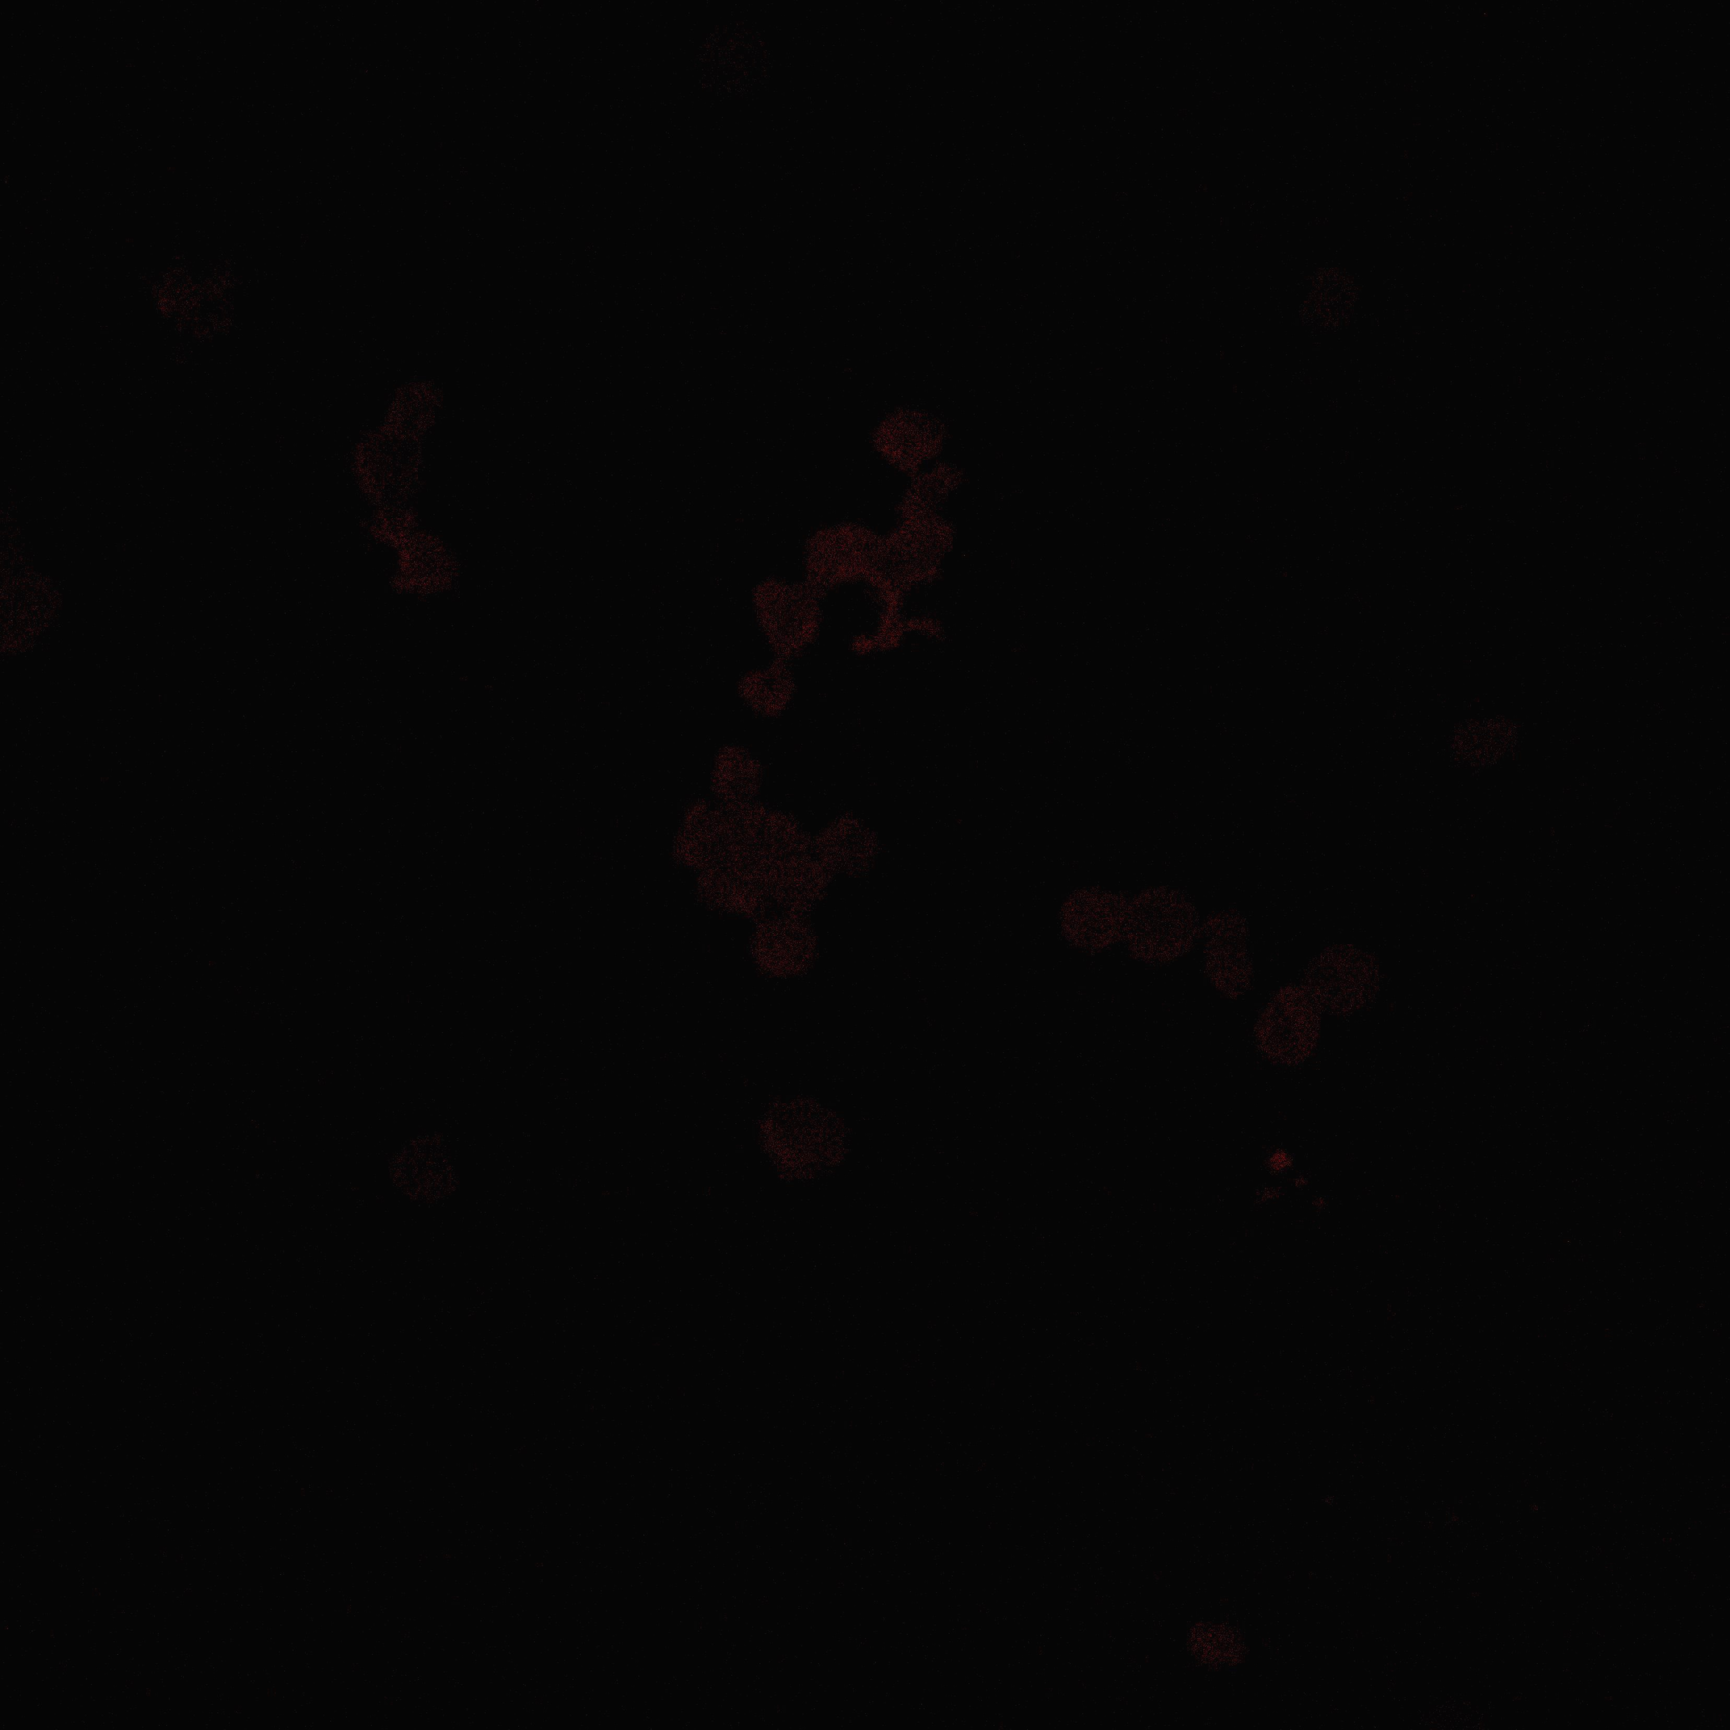
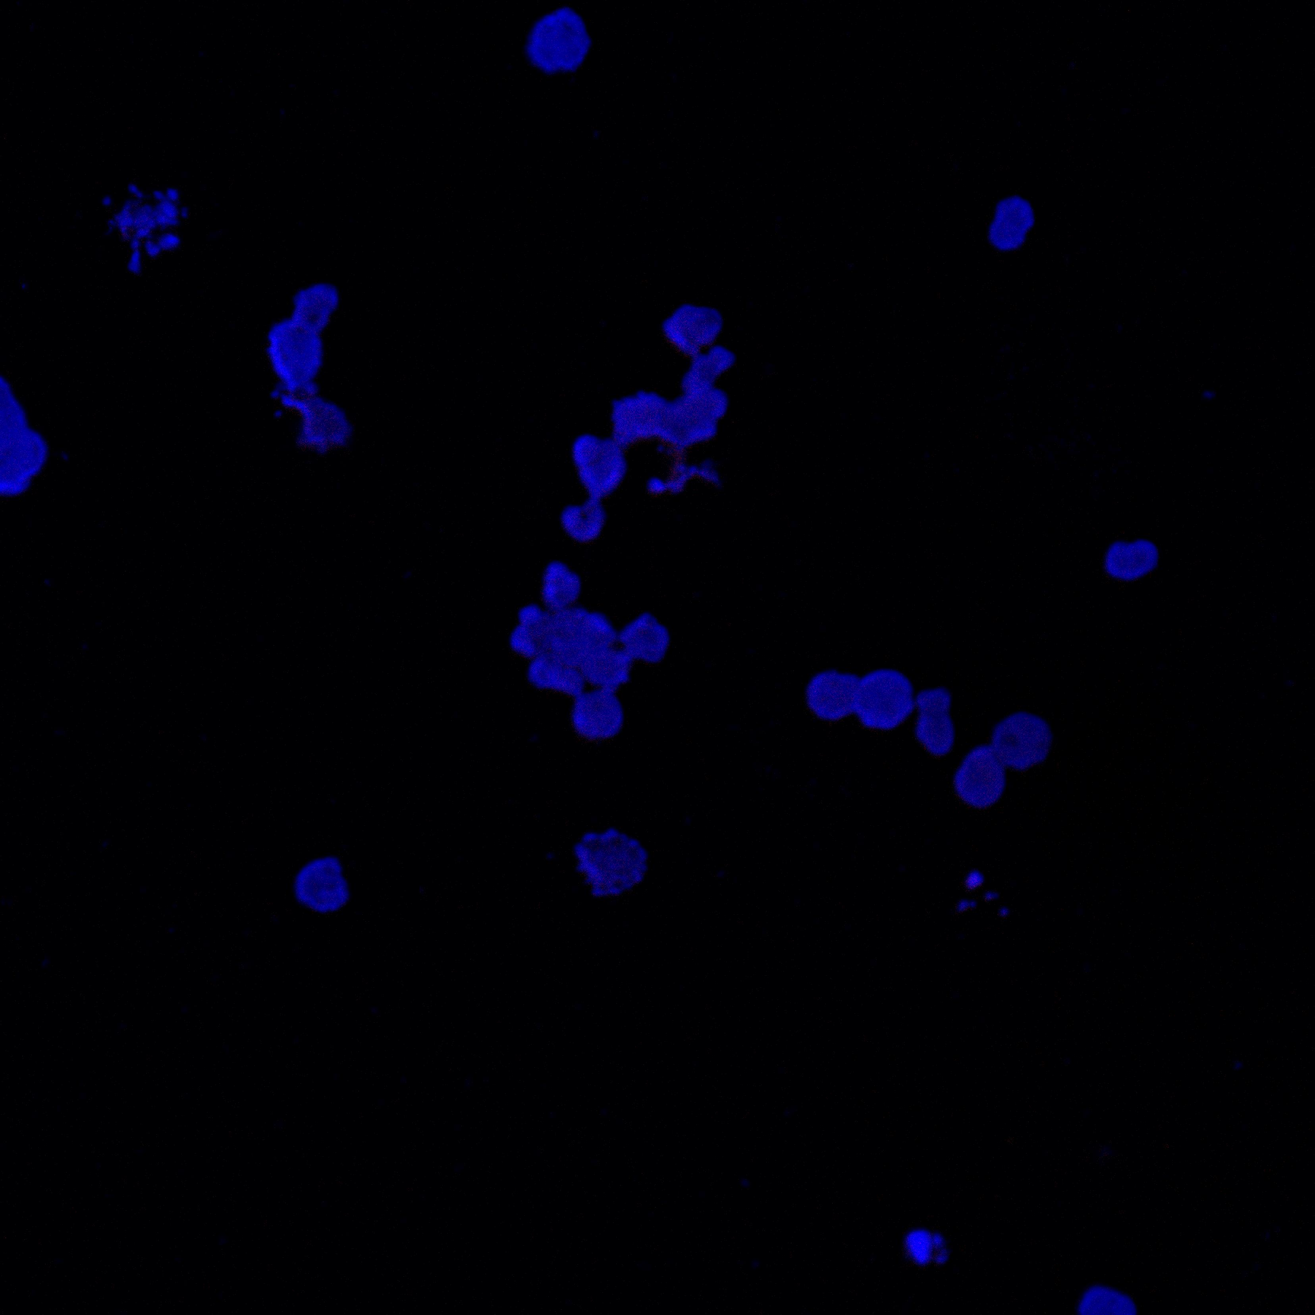
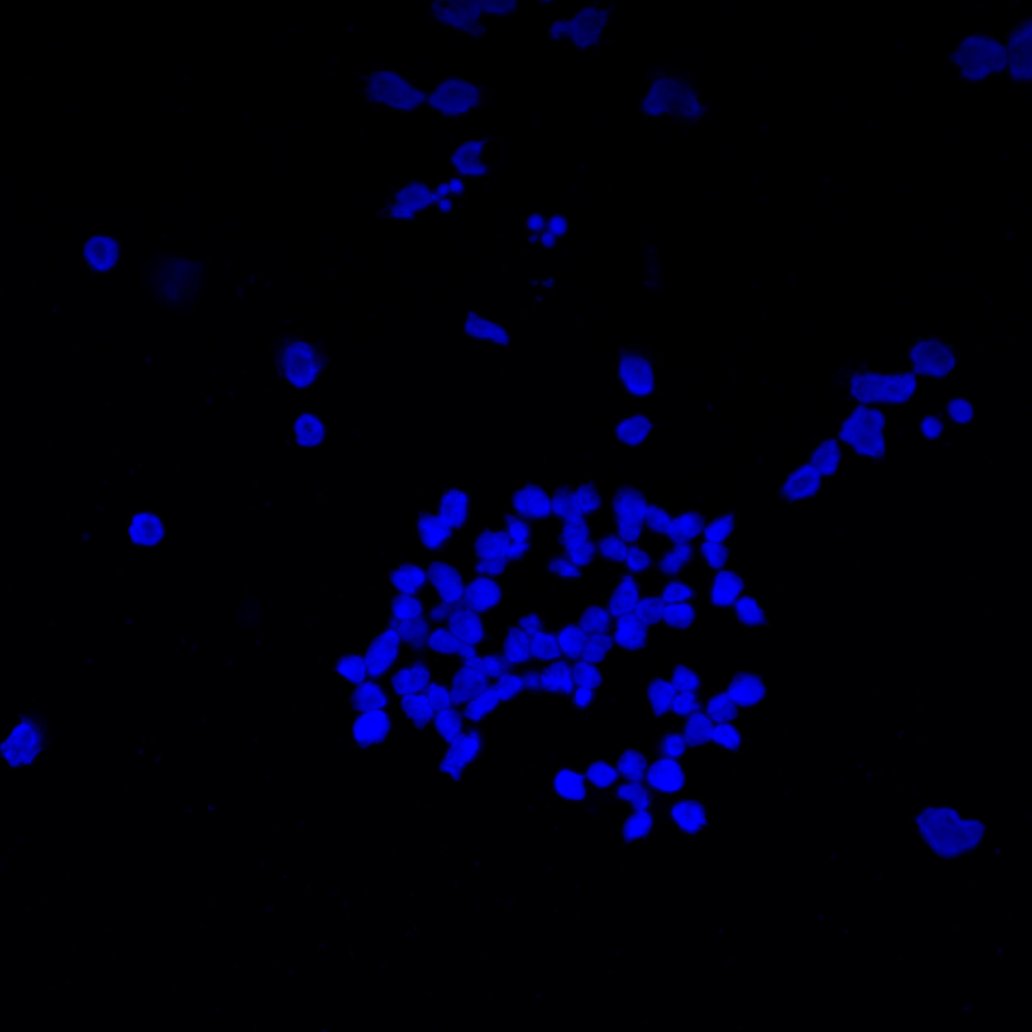
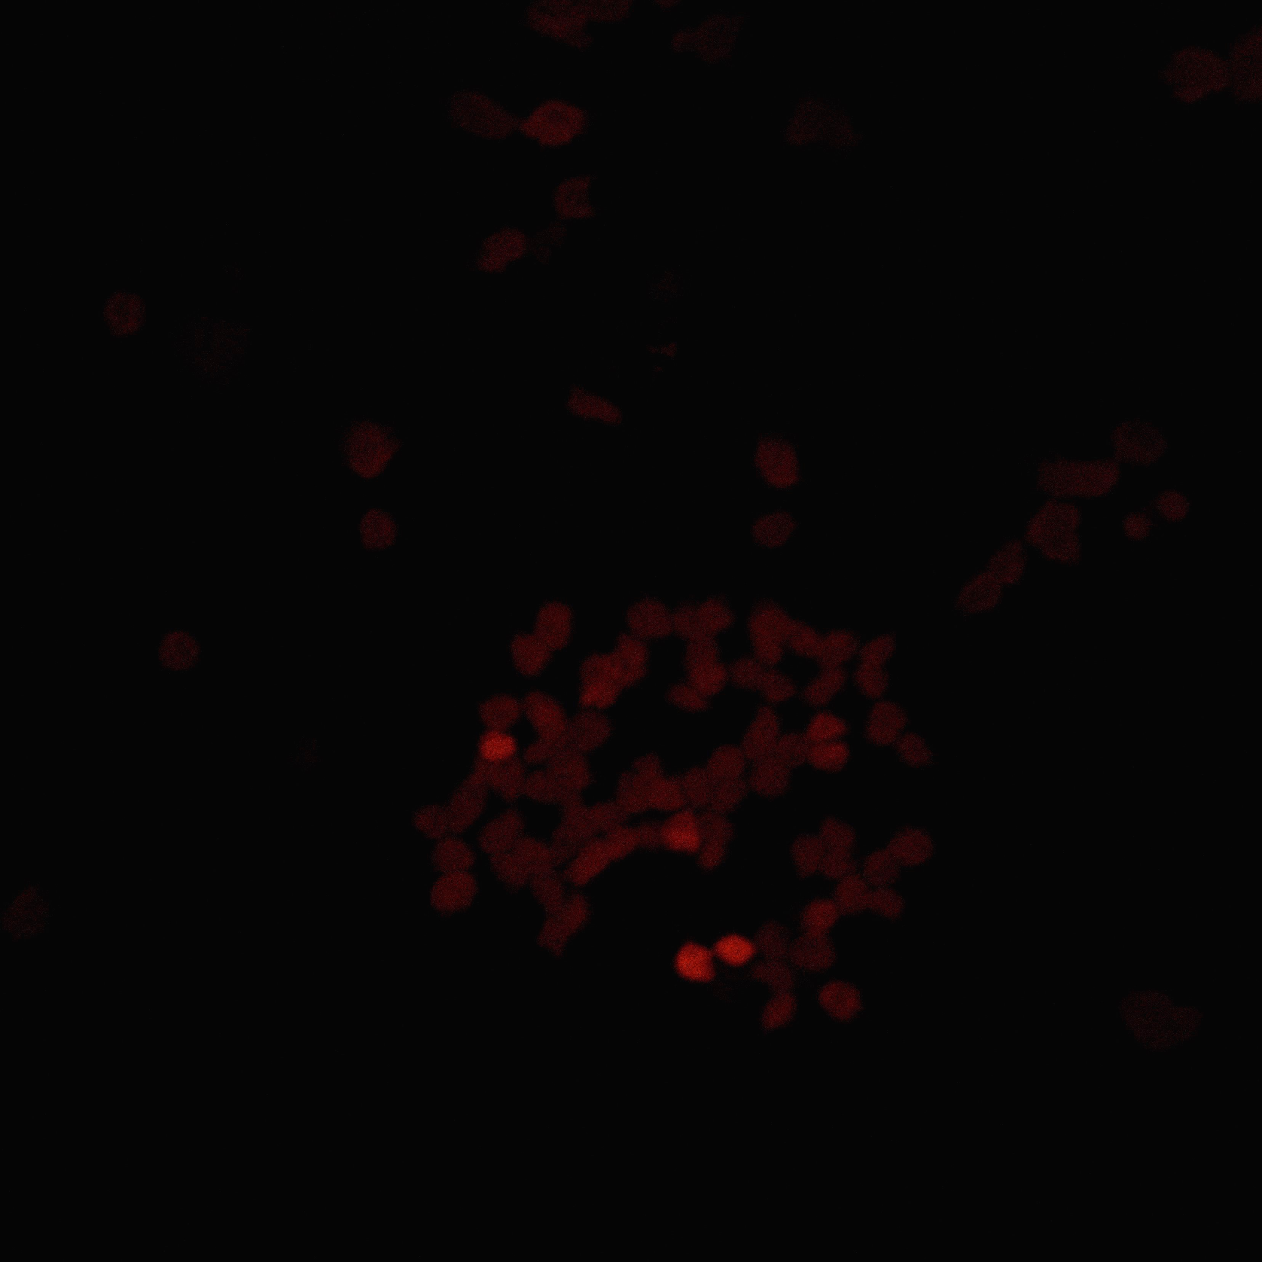
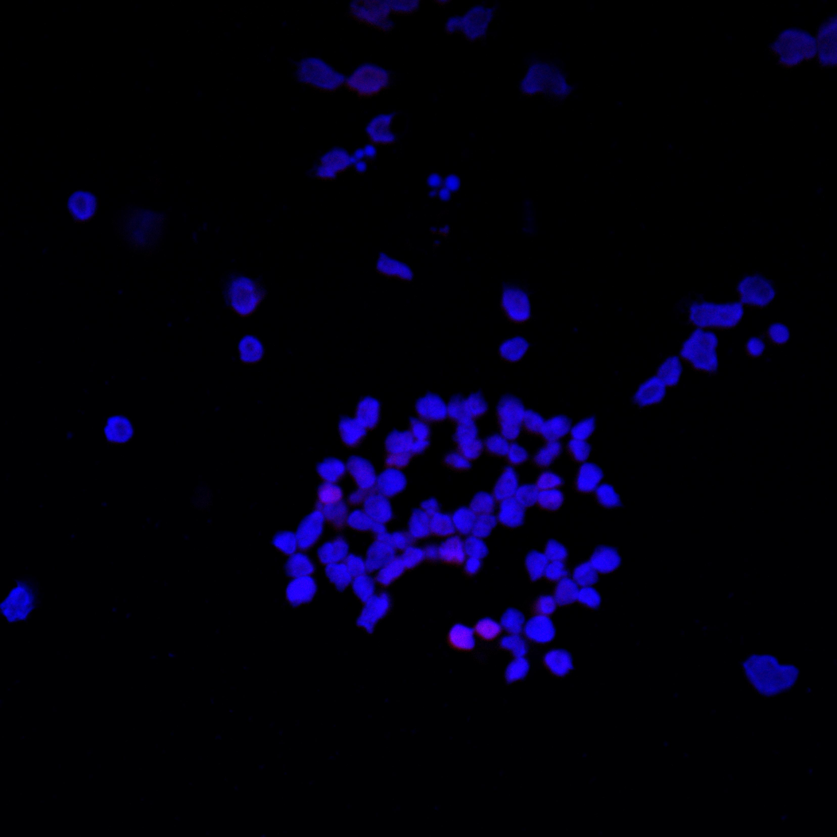
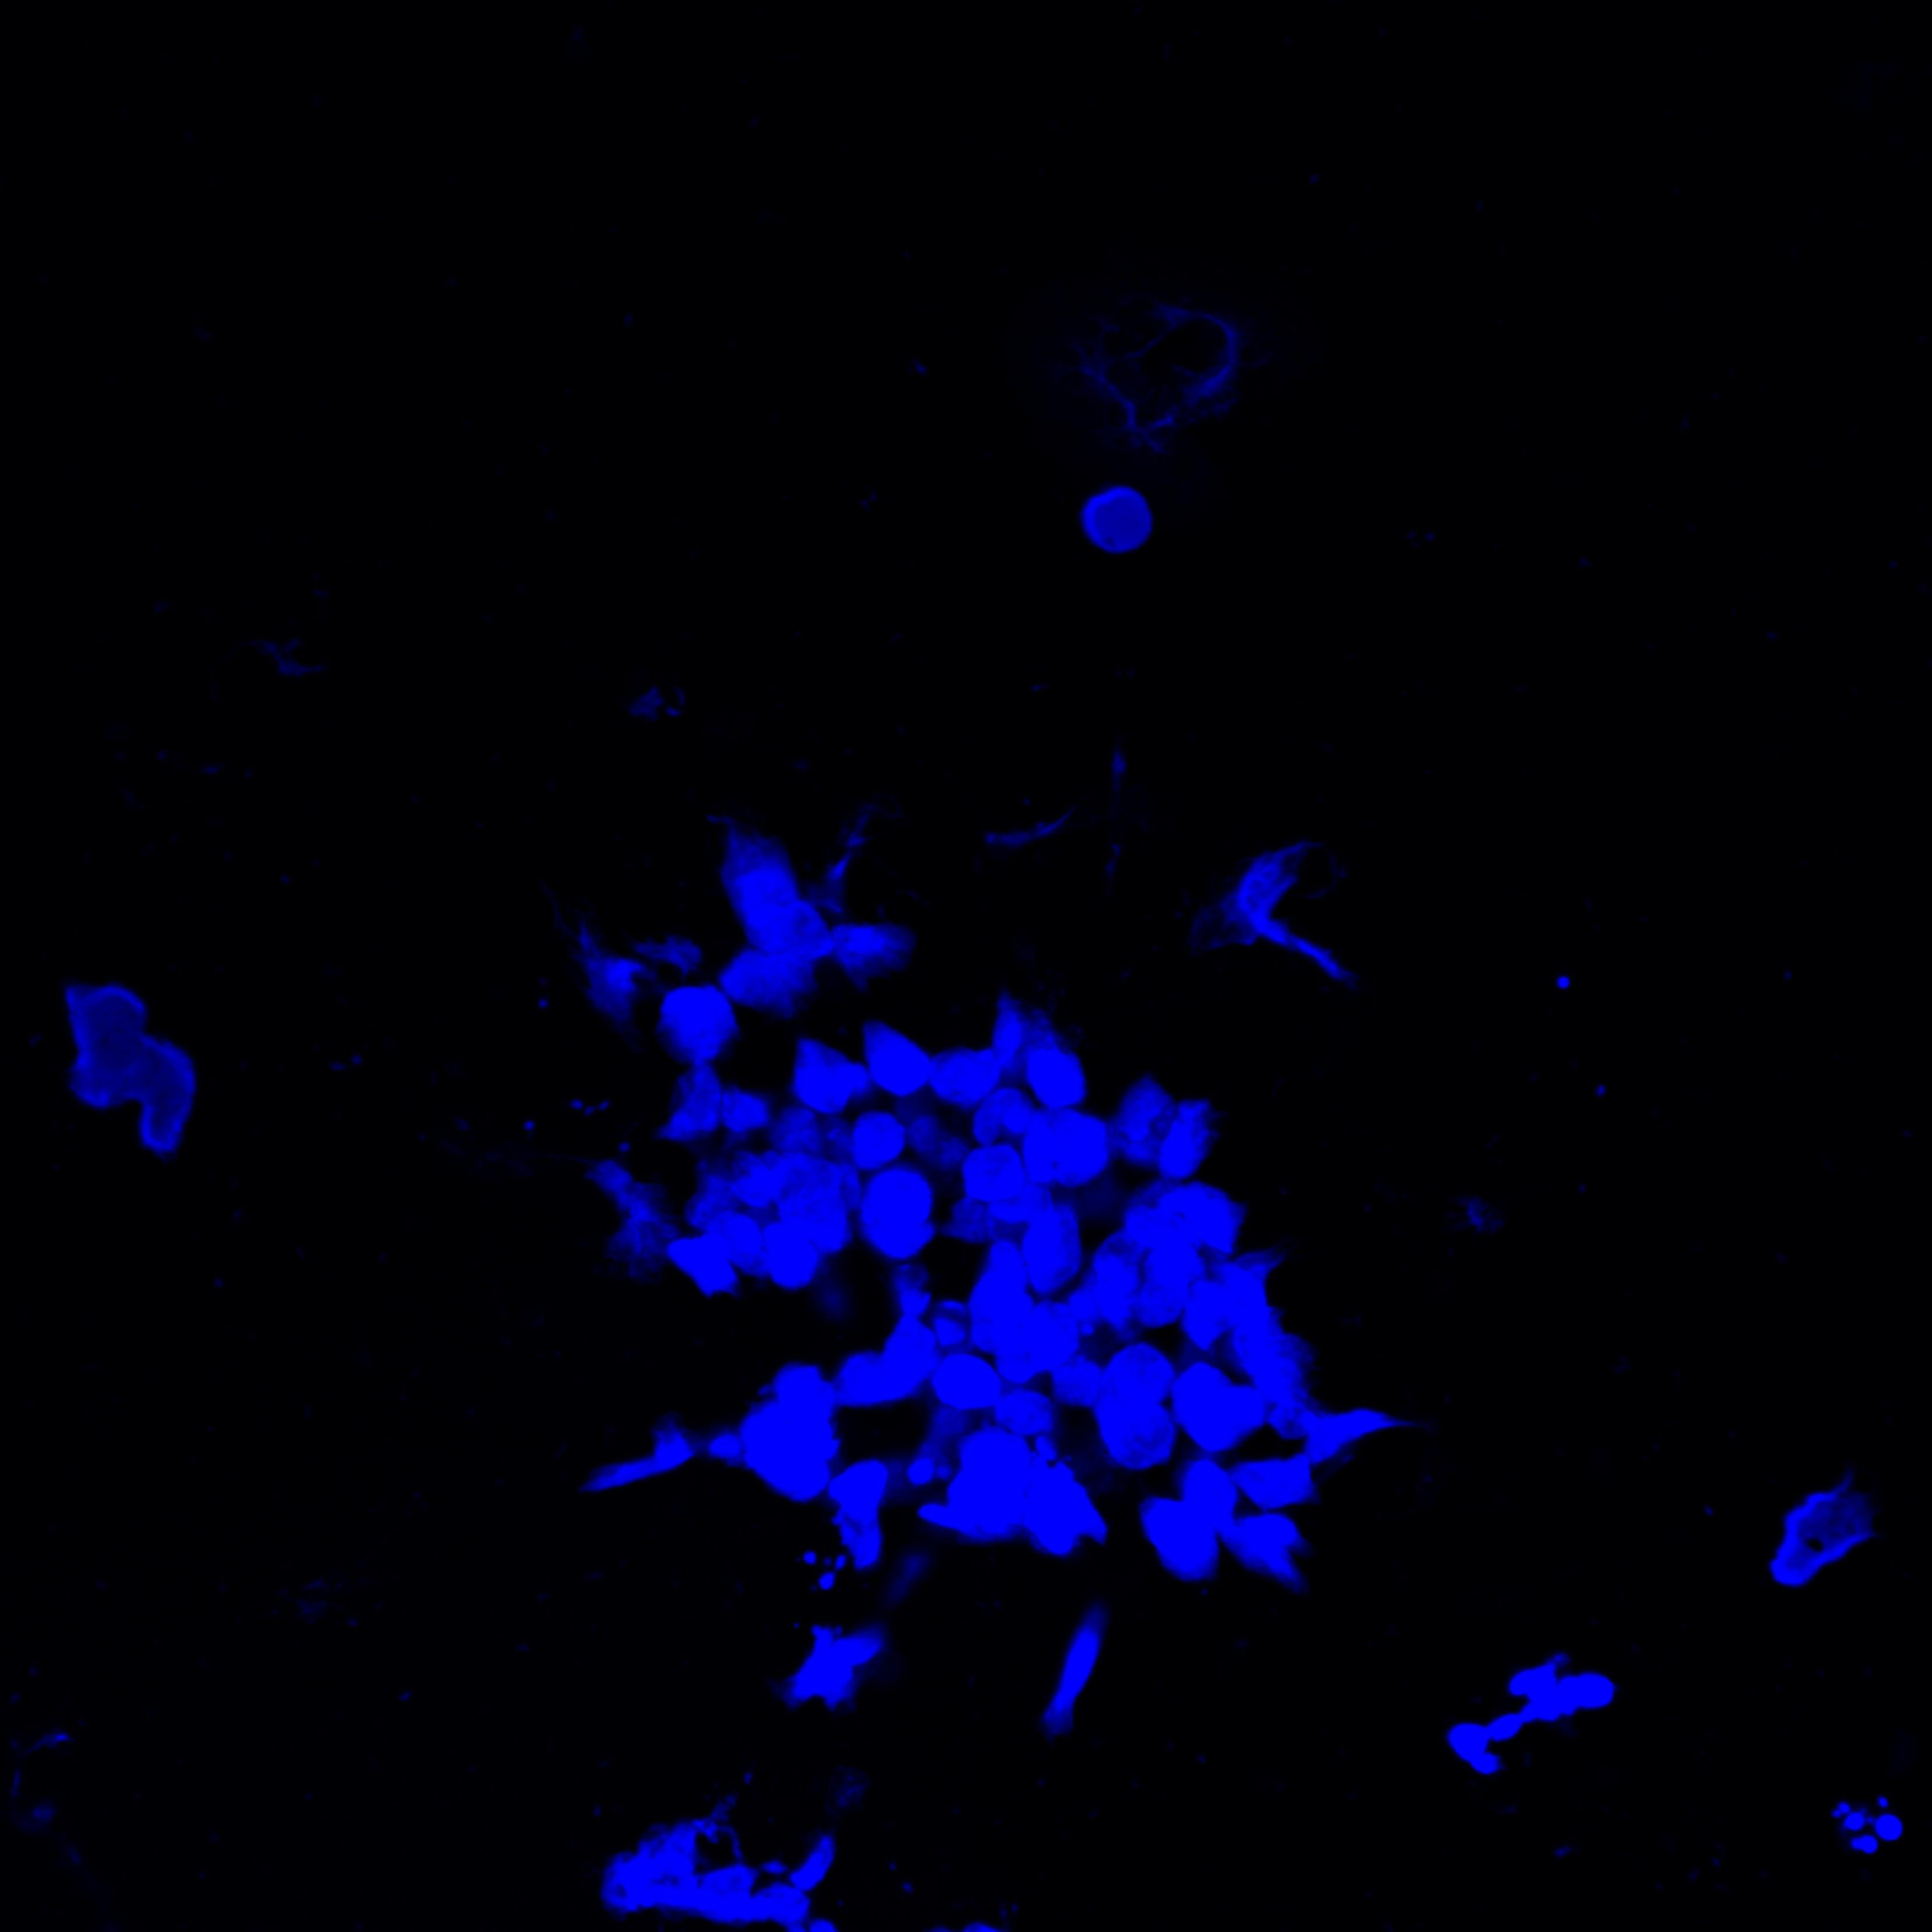
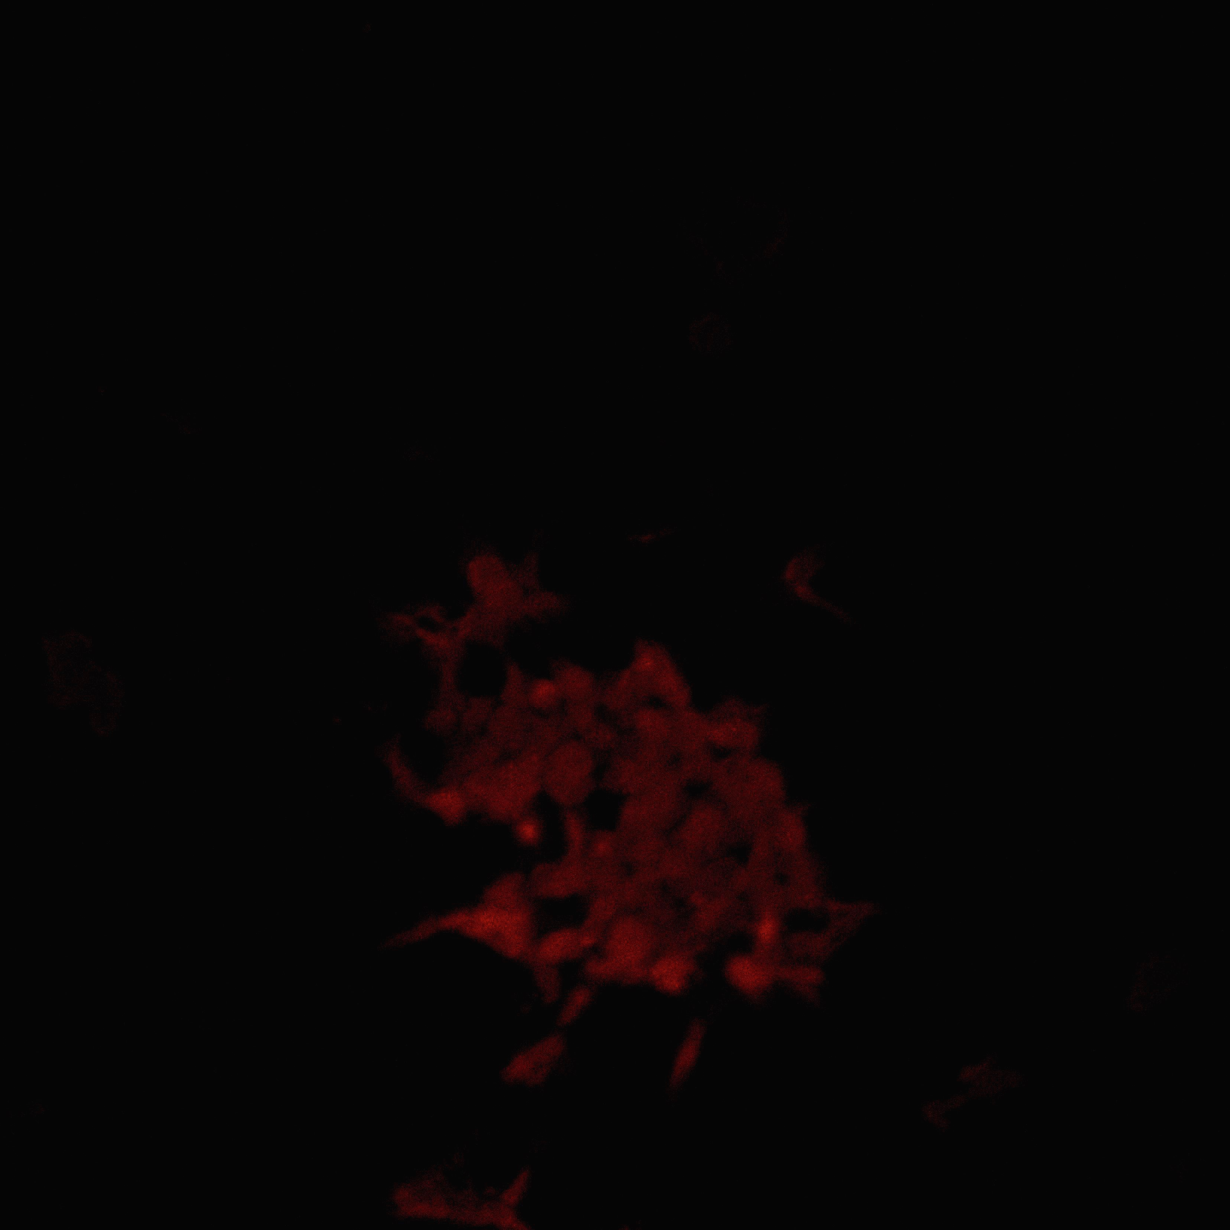
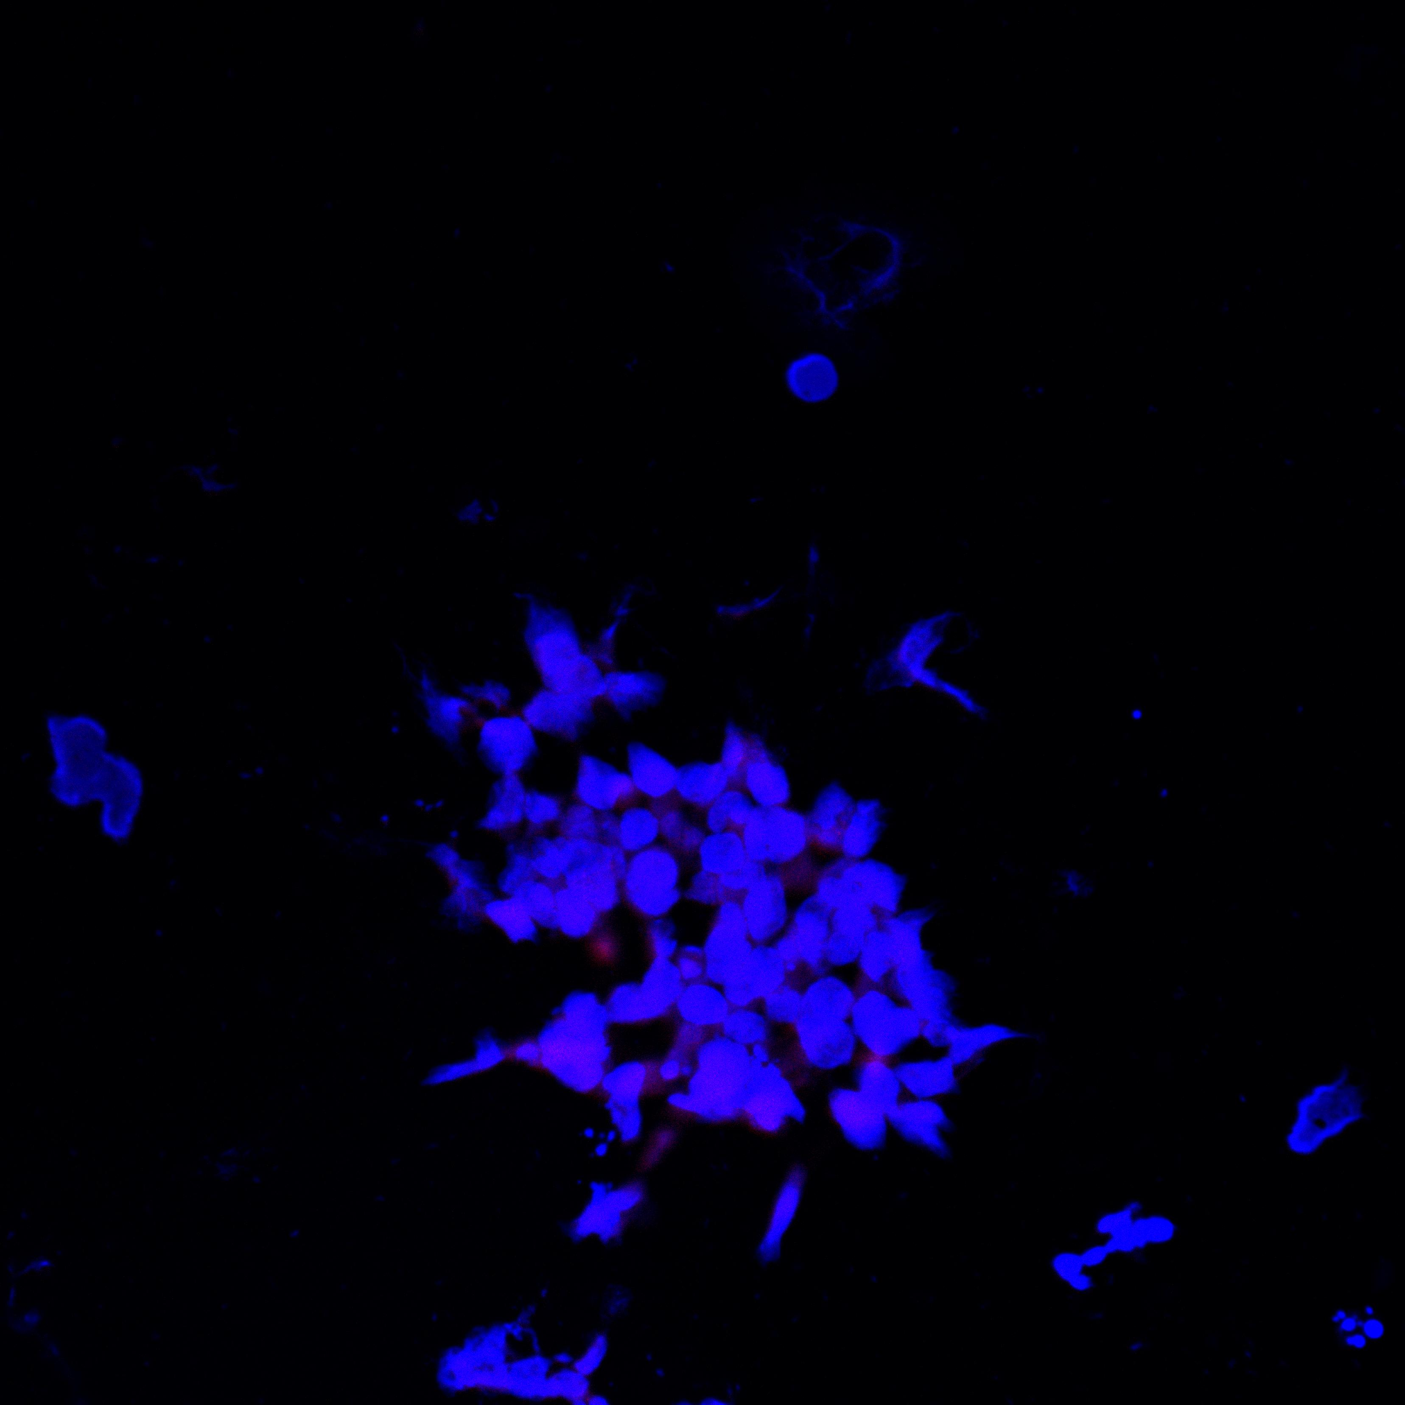
HUT78 Nice IF
DAPI Texas-Red-dATP Merge
Mean pixel intensity/number of Nuclei
No Nicking enzyme: 6.48.10⁻⁵ -/+ 2.42. 10⁻⁵
Nicking enzyme: 0.000267-/+ 0.000148
Nicking enzyme + Trichostatin A: 0.000413-/0.000156

